Slide 1
Networking Topics
Network

Slide 2
TOPICS in Session
OSI Model
IP Protocols
Routing and Switching
VLAN's
TCP/ IP
HTTP Protocol
DNS
Load Balancers
Proxy Servers
VPN
Firewall
DMZ
Vulnerability Tools

Slide 3
OSI Layers

Slide 4
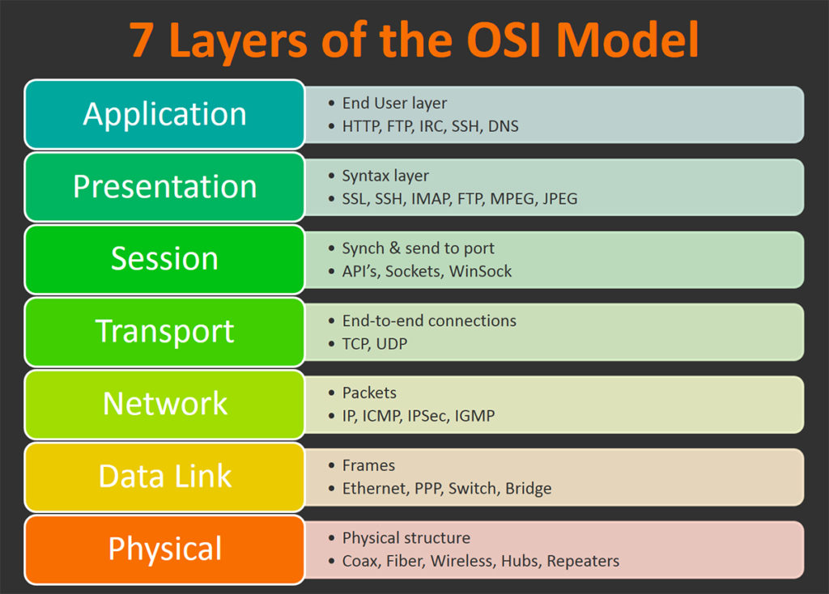
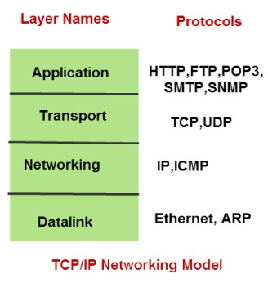
OSI Layers
OSI stands for Open Systems Interconnection.
It has been developed by ISO – ‘International Organization of Standardization‘
It is a 7 layer architecture with each layer having specific functionality to perform.
All these 7 layers work collaboratively to transmit the data from one person to another across the globe.

Slide 5
OSI Layers Explained Physical Layer (Layer 1) - It is responsible for the actual physical connection between the devices. The physical layer contains information in the form of bits. It is responsible for the actual physical connection between the devices. Data Link Layer (DLL) (Layer 2) - The data link layer is responsible for the node to node delivery of the message. The main function of this layer is to make sure data transfer is error free from one node to another, over the physical layer. Network Layer (Layer 3) - Network layer works for the transmission of data from one host to the other located in different networks. It also takes care of packet routing i.e. selection of the shortest path to transmit the packet, from the number of routes available. Transport Layer (Layer 4) - Transport layer provides services to application layer and takes services from network layer. The data in the transport layer is referred to as Segments. It is responsible for the End to End delivery of the complete message. Session Layer (Layer 5) - This layer is responsible for establishment of connection, maintenance of sessions, authentication and also ensures security. Presentation Layer (Layer 6) - Presentation layer is also called the Translation layer.The data from the application layer is extracted here and manipulated as per the required format to transmit over the network. Application Layer (Layer 7) - These applications produce the data, which has to be transferred over the network. This layer also serves as a window for the application services to access the network and for displaying the received information to the user.

Slide 6
IP Protocols

Slide 7
Different types of IP Protocols
Transmission Control Protocol (TCP) – It is used for data transmission. It works with and complements IP, which is why the two are often paired together as TCP IP. TCP IP is the most widely used communications protocol.
User Datagram Protocol (UDP) – It is used by programs to send short datagram messages. it is connection less protocol and doesn’t guarantee delivery
Internet Control Message Protocol (ICMP) – It is messages used for diagnostic or error-generating purposes.
Hypertext Transfer Protocol (HTTP) – It is application protocol that uses hyperlinks between nodes containing text. It is the underlying protocol used by the World Wide Web and this protocol defines how messages are formatted and transmitted, and what actions Web servers and browsers should take in response to various commands.
Post Office Protocol (POP) – It is used by local email clients to retrieve email from a remote server over TCP IP
File Transfer Protocol (FTP) – It is protocol to transfer computer files from a server to a client and vice versa
Internet Message Access Protocol (IMAP) – It is a communication protocol used by email clients to retrieve messages from a mail server over TCP IP

Slide 8
Routing and Switching

Slide 9
Routing and switching are the basic functions of network communication. Routing and Switching are different functions of network communications. The main differences between Routing and Switching are as below. The function of Switching is to switch data packets between devices on the same network (or same LAN - Local Area Network). The function of Routing is to Route packets between different networks (between different LANs - Local Area Networks). Switches operate at Layer 2 of the OSI Model (Datalink Layer). A switch knows where to send a data packet by using Layer 2 addresses (MAC address - hardware address of a network adapter). A switch maintains a table of MAC addresses (MAC Address table or CAM Table) and what physical switch port they are connected to. The Switching function can be explained more simply that, Switching is the function of moving data packets (Ethernet Frames) within the same LAN (Local Area Network). Routers operate at Layer 3 of the OSI Model (Network layer). A Router knows where to send a packet by using Network part of the destination IP address. A Router maintains a table called Routing Table and uses the routing table to determine the route to the destination network.

Slide 10
Virtual Local Area Networks (VLANs)

Slide 11
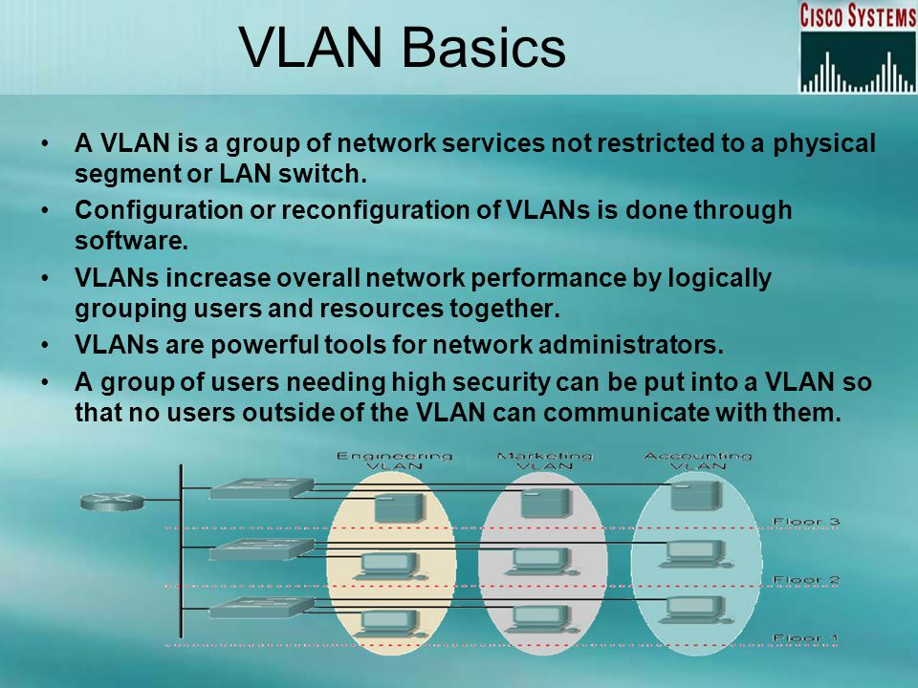

Slide 12
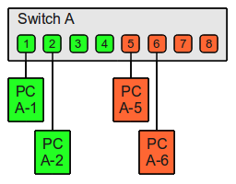
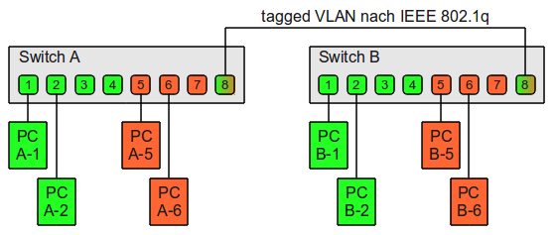
Virtual Local Area Networks (VLANs) divide a single existing physical network into multiple logical networks. Thereby, each VLAN forms its own broadcast domain. Communication between two different VLANs is only possible through a router that has been connected to both VLANs. VLANs behave as if they had been constructed using switches that are independent of each other. In principle, there are two approaches to implementing VLANs: Port-based VLANs (untagged) Tagged VLANs

Slide 13
TCP/IP(Transmission Control Protocol/ Internet Protocol)

Slide 14
TCP/IP (Transmission Control Protocol/Internet Protocol) is the basic communication language or protocol of the Internet. It can also be used as a communications protocol in a private network (either an intranet or an extranet).
When you are set up with direct access to the Internet, your computer is provided with a copy of the TCP/IP program just as every other computer that you may send messages to or get information from also has a copy of TCP/IP.
TCP/IP is a two-layer program
1. The higher layer, Transmission Control Protocol (TCP), manages the assembling of a message or file into smaller packets that are transmitted over the Internet and received by a TCP layer that reassembles the packets into the original message.
2. The lower layer, Internet Protocol (IP), handles the address part of each packet so that it gets to the right destination.
TCP/IP and the Internet are inextricably linked. Although no organization owns the Internet or its technologies, a number of organizations are responsible for the development of the Internet and so TCP/IP.

Slide 15
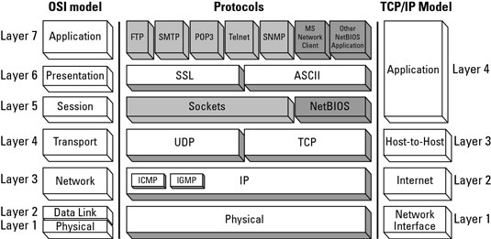
TCP IP Suite
Network interface (layer 1): Deals with all physical components of network connectivity between the network and the IP protocol
Internet (layer 2): Contains all functionality that manages the movement of data between two network devices over a routed network
Host-to-host (layer 3): Manages the flow of traffic between two hosts or devices, ensuring that data arrives at the application on the host for which it is targeted
Application (layer 4): Acts as final endpoints at either end of a communication session between two network hosts

Slide 16
HTTP (HyperText Transfer Protocol)

Slide 17
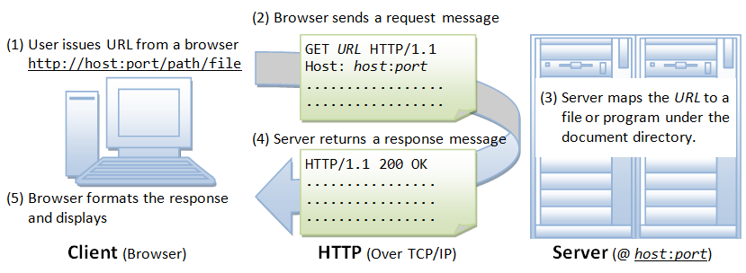
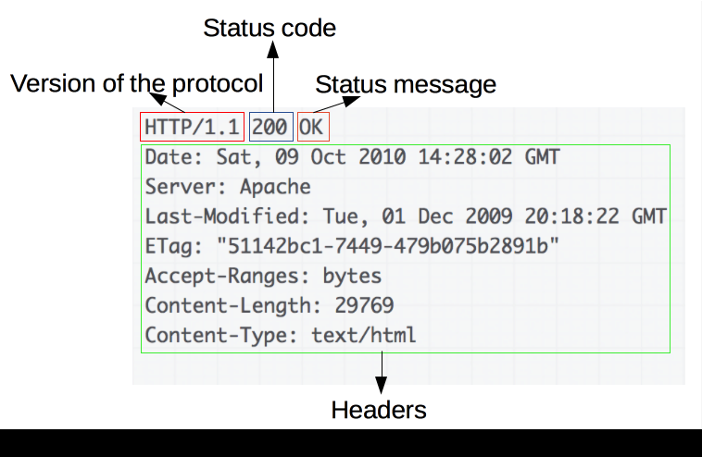
HTTP is the underlying protocol used by the World Wide Web and this protocol defines how messages are formatted and transmitted, and what actions Web servers and browsers should take in response to various commands.
For example, when you enter a URL in your browser, this actually sends an HTTP command to the Web server directing it to fetch and transmit the requested Web page.
HTTP is called a stateless protocol because each command is executed independently, without any knowledge of the commands that came before it. This is the main reason that it is difficult to implement Web sites that react intelligently to user input.

Slide 18
DNS (Domain Name System)

Slide 19
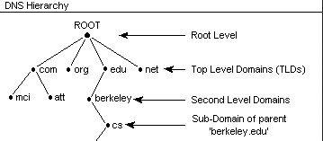
A Domain Name is a human-readable name—like amazon.com—that we type in a web browser URL field. The Internet Corporation for Assigned Names and Numbers (ICANN) manages these domain names
Top Level Domain (TLD)
com – Commercial businesses.
gov – U.S. government agencies.
edu – Educational institutions such as universities.
org – Organizations (mostly non-profit).
mil – Military.
net – Network organizations.
eu – European Union.
Second Level Domain
Sub Domain

Slide 20
Different types of DNS Entries
A Record
Address record. A Records map server IP addresses to domain names. For example, 72.21.206.6 to amazon.com.
CNAME
Canonical Name record. A CNAME record establishes one domain as an alias to another (thereby routing all traffic addressed to the alias to the target; the canonical address).
Alias Record
Like a CNAME record, Alias records can be used to map one address to another. But Aliases can coexist with other records using the same name.
MX Record
Mail Exchange Record. These records will redirect a domain’s email to the servers hosting the domain’s user accounts. Mail exchange records are used for determining the priority of email servers for a domain.

Slide 21
Load Balancers F5

Slide 22
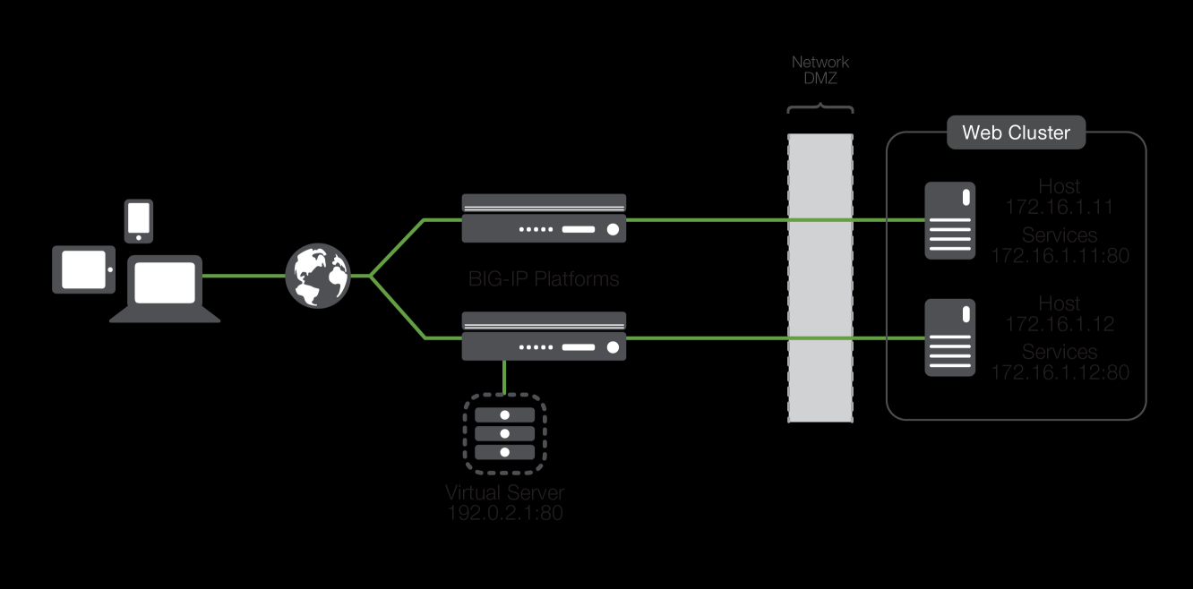
A Load Balancer is a device that acts as a reverse proxy and distributes network or application traffic across a number of servers.
Load balancers are used to increase capacity (concurrent users) and reliability of applications.
They improve the overall performance of applications by decreasing the burden on servers associated with managing and maintaining application and network sessions, as well as by performing application-specific tasks.
Load balancers are generally grouped into two categories: Layer 4 and Layer 7. Layer 4 load balancers act upon data found in network and transport layer protocols (IP, TCP, FTP, UDP).
Layer 7 load balancers distribute requests based upon data found in application layer protocols such as HTTP.

Slide 23
Proxy Servers

Slide 24
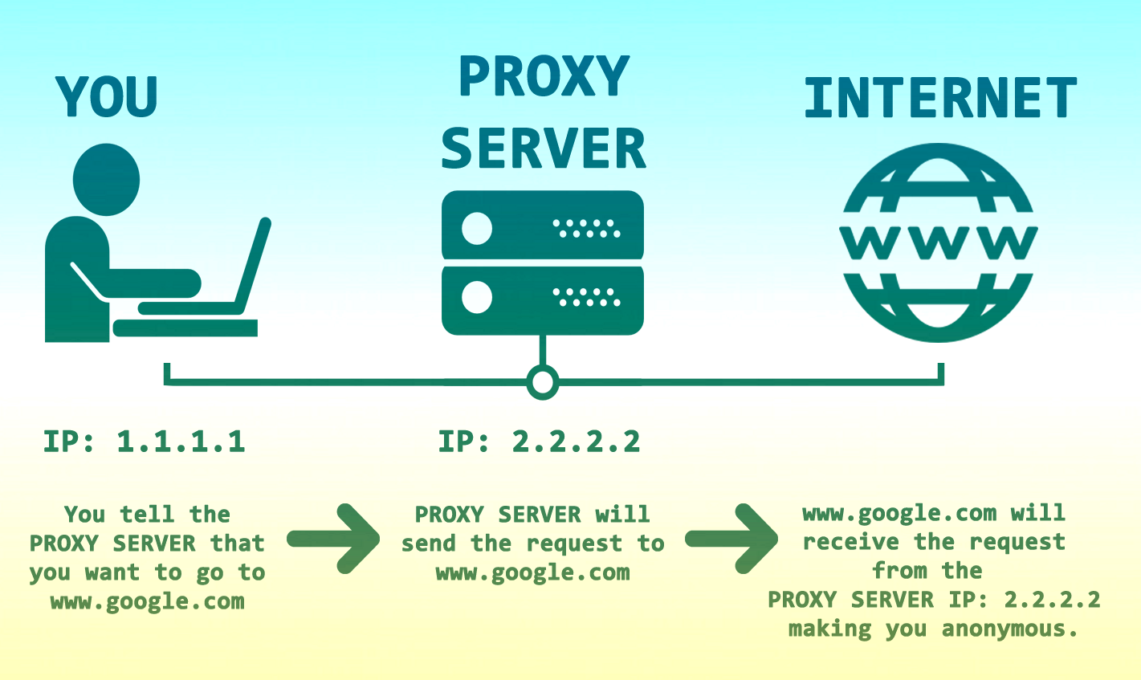
In computer networks, a Proxy Server is a server (a computer system or an application) that acts as an intermediary for requests from clients seeking resources from other servers.
A proxy lets you go online under a different IP address identity.
You don't change your Internet provider; you simple go online and search for "free proxies" or "list of proxies" and you will get several websites that provide lists of free proxies.
It's really that simple to find proxies, just like you order shoes, movies and airline tickets online. However, it isn't so simple to figure out how to use one without some guidance.
While using a proxy, your Internet request goes from your computer to your ISP as usual, but then gets sent to the proxy server, and then to the website/destination. Along the way, the proxy uses the IP address you chose in your setup, masking your real IP address.

Slide 25
VPN (Virtual Private Networks)

Slide 26
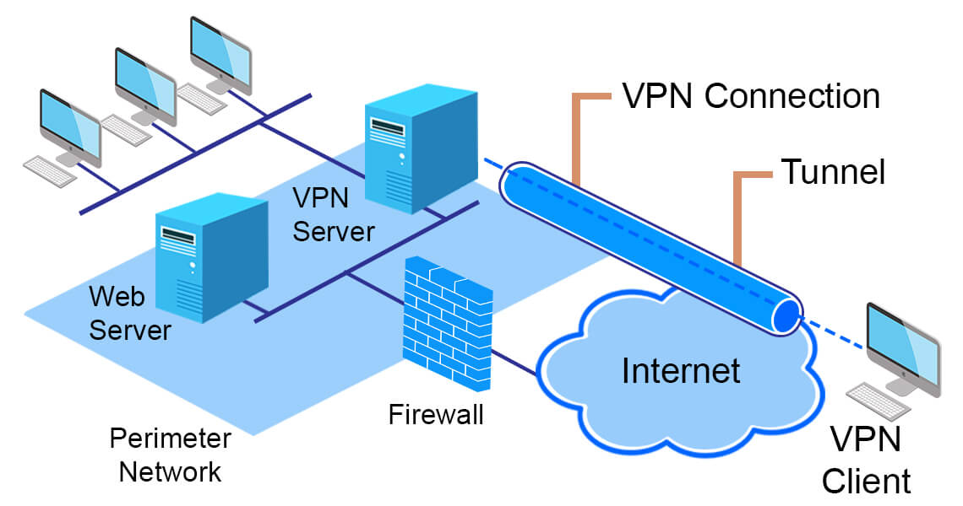
A virtual private network, or VPN, is an encrypted connection over the Internet from a device to a network. The encrypted connection helps ensure that sensitive data is safely transmitted.
It prevents unauthorized people from eavesdropping on the traffic and allows the user to conduct work remotely. VPN technology is widely used in corporate environments.
A VPN extends a corporate network through encrypted connections made over the Internet. Because the traffic is encrypted between the device and the network, traffic remains private as it travels.
An employee can work outside the office and still securely connect to the corporate network. Even smartphones and tablets can connect through a VPN.
Secure remote access provides a safe, secure way to connect users and devices remotely to a corporate network.

Slide 27
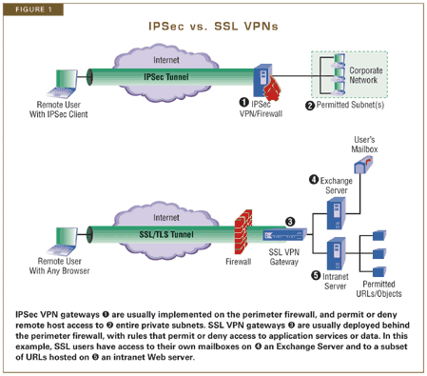
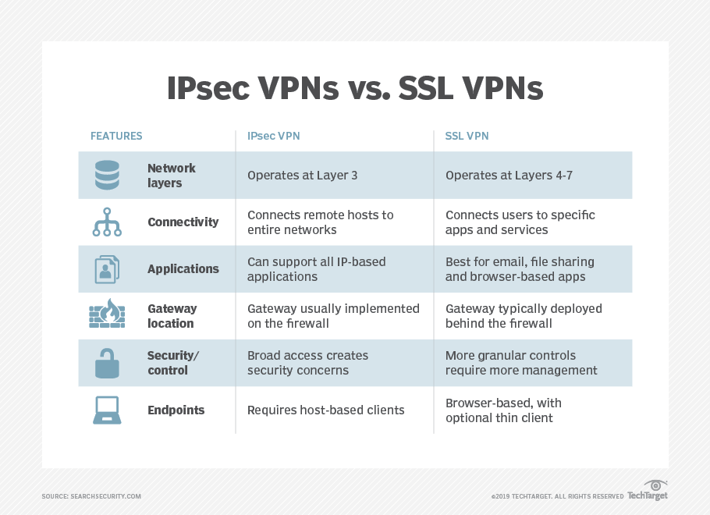
IPSec vs. SSL VPNs

Slide 28
Firewalls

Slide 29
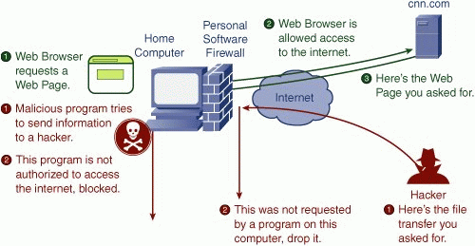
A Firewall is simply a program or hardware device that filters the information coming through the Internet connection into your private network or computer system. If an incoming packet of information is flagged by the filters, it is not allowed through.
Packet filtering - Packets (small chunks of data) are analyzed against a set of filters. Packets that make it through the filters are sent to the requesting system and all others are discarded.
Proxy service - Information from the Internet is retrieved by the firewall and then sent to the requesting system and vice versa.
Stateful inspection - A newer method that doesn't examine the contents of each packet but instead compares certain key parts of the packet to a database of trusted information. Information traveling from inside the firewall to the outside is monitored for specific defining characteristics, then incoming information is compared to these characteristics. If the comparison yields a reasonable match, the information is allowed through. Otherwise it is discarded.

Slide 30
DMZ (Demiltarized Zone)

Slide 31
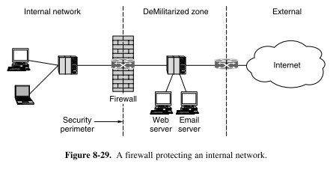
A DMZ is a secure server that adds an additional layer of security to a network and acts as a buffer between a local area network (LAN) and a less secure network which is the Internet.
A DMZ server is known as a Data Management Zone and provides secure services to local area network users for email, Web applications, ftp, and other applications that require access to the Internet.
DMZ in networking gets its name from the demilitarized zones, which is land that the military would use as a barrier against the enemy.
A DMZ is a management server that is placed on the network that contains multiple network interfaces that play specific roles in protecting the local area network (LAN).
Although a regular network firewall is installed to provide protection for the local area network, a DMZ establishes rules for protecting the DMZ network from the Internet.

Slide 32
Vulnerabilities

Slide 33
Vulnerability management is a security practice specifically designed to proactively mitigate or prevent the exploitation of IT vulnerabilities which exist in a system or organization.
Top 10 Vulnerability Assessment Scanning Tools
Comodo HackerProof
OpenVAS
Nexpose Community
Nikto
Tripwire IP360
Wireshark
Aircrack
Nessus Professional
Retina CS Community
Microsoft Baseline Security Analyzer (MBSA)
The process involves the identification, classification, remedy, and mitigation of various vulnerabilities within a system.
It is an integral part of computer and network security and is practiced together with risk management as well as other security practices.
Wireshark is an extensively used network protocol analyzer considered to be the most powerful tool in the security practitioners toolkit.
However, vulnerability scanning is simply a process under vulnerability management together with aspects like risk acceptance and remediation of risk.

Slide 34
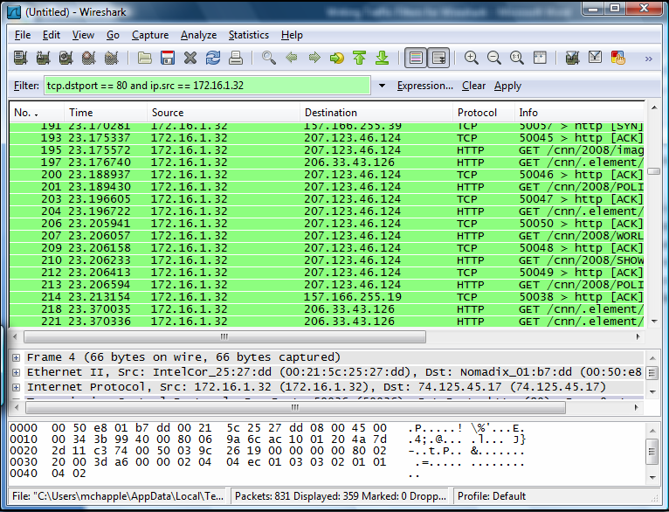
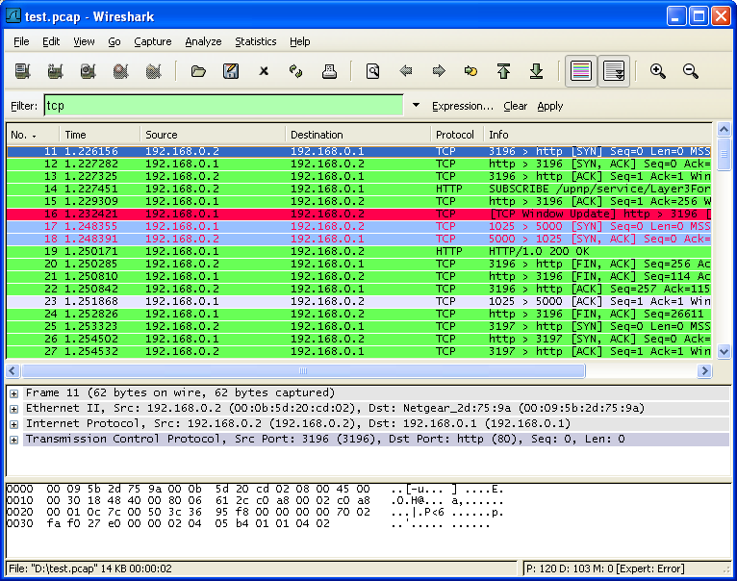
Wireshark Examples

